Slide 1
Detecting and Classifying Floating-Point Errors: A Cluster-Based FPGen Evaluation
Research Idea Proposal
Alexander LaChapelle
Nikhil Kumar Gattu

Slide 2
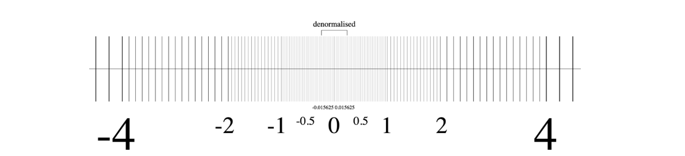
Background
Many computational problems involve working with real numbers
On a computer, real numbers must be rounded to floats
Floating point numbers can be inaccurate, especially near edges of the distribution
Inaccuracy in floats is known as floating point error
FPGen is a tool that finds floating-point numbers that can cause big errors in calculations. It does this by testing different numbers and seeing where the biggest mistakes happen.
Symbolic execution is a method that runs a program by using symbols instead of actual numbers. This helps find all possible mistakes and creates test cases that can lead to errors.
[1]

Slide 3
Problem statement
How to write tests that can detect floating point errors?
We need to know how to purposefully generate a floating-point input that is error-prone
Several tools exist to generate these inputs, but we will be focusing on FPGen – which is notable for using symbolic execution.
FPGen has been tested on a general dataset, but we don’t know which types of numerical computations it works best for.
Our goal is to test FPGen on different clusters to see where it’s most effective.
Important to know if FPGen works, and further than that, where it works best

Slide 4
Research Questions
RQ1: Are the original paper’s conclusions replicable?
RQ2: Do certain classes of computational problem benefit more from FPGen?
RQ3: Does FPGen perform equally well across different numerical computations?
Plus, some additional questions that could be explored:
RQ4: Can FPGen be extended to other popular scientific computing libraries such as numpy?
RQ5: Can FPGen benchmarks be improved by numerical analysis or heuristic techniques?

Slide 5
Key Insight
Floating-point errors behave differently in different types of computations.
We can create a classification system for the test programs
Examples: additive vs multiplicative, scalar vs vector
Then we compare the performance gains from FPGen across these classifications
Symbolic execution will be handled by a 3rd party tool, so not necessary to worry about the details so far

Slide 6
Evaluation
Manually classifying programs into categories:
Cluster 1: Additive computations (Summation, Dot Product).
Cluster 2: Multiplicative computations (Matrix Multiplication, LU decomposition).
Cluster 3: Mixed computations (Statistical operations like mean, variance).
Providing each cluster to FPGen.
Our expanded data set will consist of more programs from the same libraries.
Comparing FPGen’s performance using two key metrics:
Run time
Magnitude of the error itself (expected – measured value)
Identify which cluster FPGen detects more floating-point errors in.
Find FPGen’s strengths & weaknesses across different types of computations.

